Slide 1
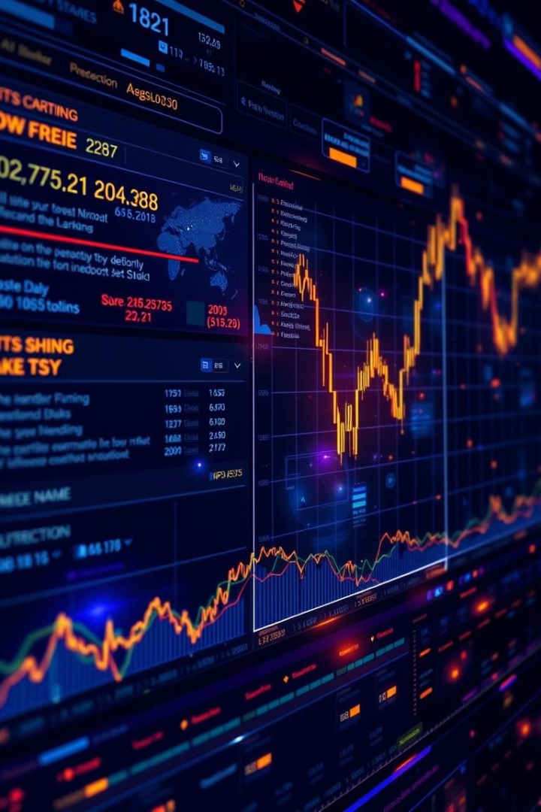
News-Driven Stock Market Prediction Using Sentiment and Time-Series Data
Presented by: [List Names] on [Insert Date]
By ABCDE

Slide 2
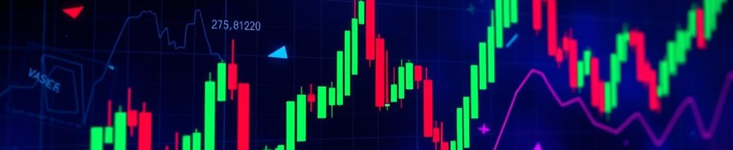
Introduction
1
Market Dynamics
2
Model Limitations
3
Prediction Importance
Stock markets react to news and public sentiment.
Traditional models struggle with sudden shocks.
Accurate stock prediction is crucial.

Slide 3
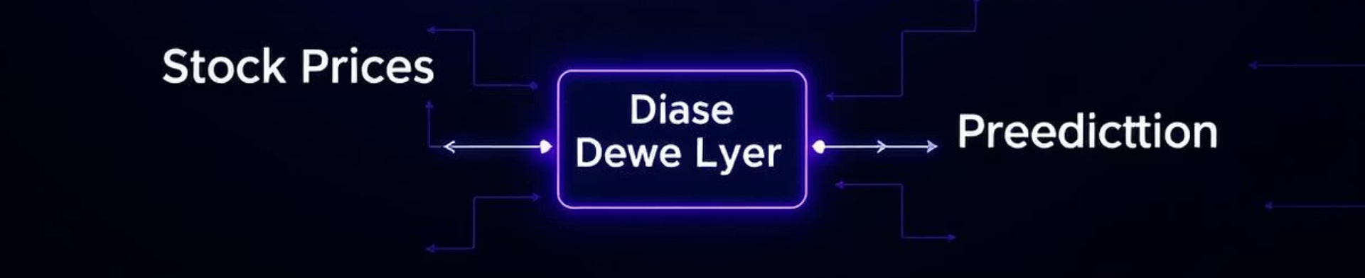




Core Idea: Hybrid Architecture
Stock Prices
News Sentiment
LSTM Fusion
Prediction
Historical data input.
Public opinion input.
Combines both data streams.
Captures trends and reactions.

Slide 4
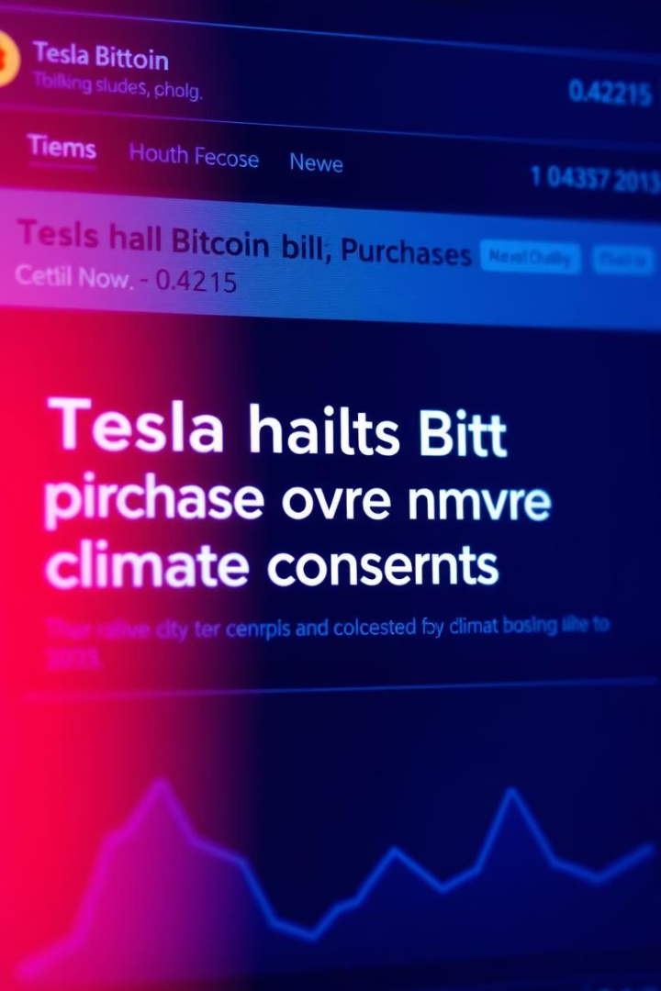
Data Sources & Preprocessing
Source
Data
Details
Yahoo Finance
TSLA Prices
2009–2017 historical data
Reddit News
Headlines
~1.5M rows, Tesla/Musk filtered
VADER/FinBERT
Sentiment
Scoring for headlines

Slide 5
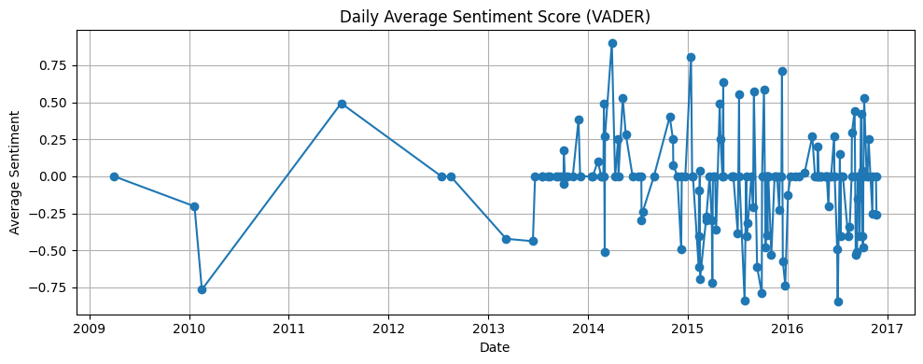
Sentiment Analysis
Daily average sentiment scores extracted and aligned with stock dates. Spikes observed in 2013 and 2015.

Slide 6
LSTM Price Prediction
Model Training
Performance
Limitation
LSTM trained on stock prices only.
RMSE: 1.24
Lacks event awareness.
MAE: 0.93

Slide 7
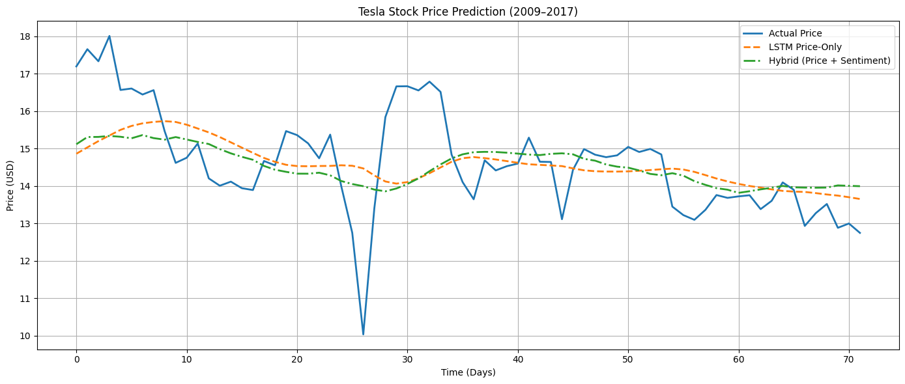
Hybrid Model – Fusion
1
Price LSTM
Processes stock price data.
2
Sentiment LSTM
Processes news sentiment data.
3
Dense Layer
Combines outputs for prediction.

Slide 8
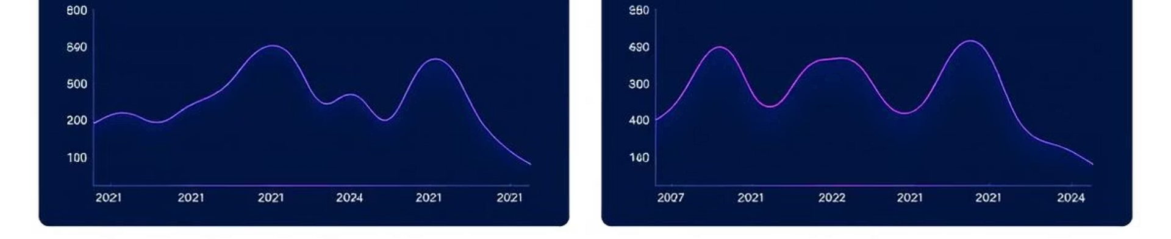
Case Study – Tesla Event
Bitcoin Tweet
Market Reaction
Hybrid Advantage
Tesla's 2021 Bitcoin tweet.
Sharp drop in sentiment and price.
Only hybrid model captured the drop.

Slide 9
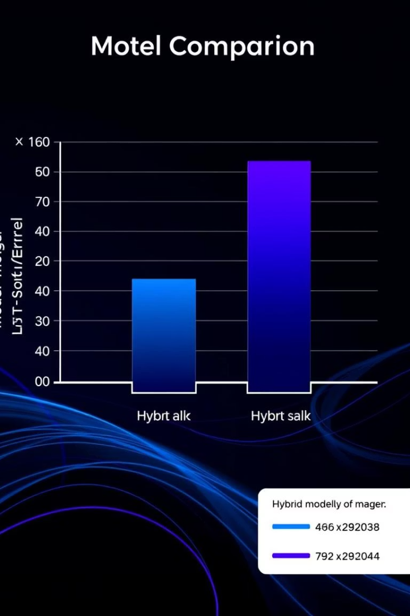
Results & Metrics
1.24
LSTM-only RMSE
Baseline error.
1.20
Hybrid RMSE
Improved error.
0.93
LSTM-only MAE
Baseline absolute error.
0.90
Hybrid MAE
Improved absolute error.

Slide 10

Challenges & Learnings
Data Quality: Inconsistent dates, sparse sentiment.
Model Training: Fusion models tricky due to imbalance.
Clear Gains: Despite challenges, clear performance improvements.

Slide 11

Conclusion & Future Work
1
Sentiment Value
"Sentiment adds real value to stock prediction."
2
Future Integration
In future, we plan to integrate real-time Twitter/X data, news tickers, and develop an interactive dashboard.

